Slide 1
Software Engineering
Lecture 2
Software Project Management

Slide 2
Today’s Learning Outcomes
Basic concepts of SE project management
  The aspects of project management
  The means of project management
Risk management
  Types of risks
  Risk management activities
  Risk assessment method
Project planning
  Planning activities
  Project plan models

Slide 3
1. Basics of Project Management
  The aspects: what to be managed
  The means: how to manage

Slide 4
The Aspects
Resource
  Human resources
  Tools (hardware and software)
  Data
  External components
  External services
Asset
  Products
  Intermediate results
  Goals and objectives
Risk
  Probability of occurrence
  Consequences
Process
  Overall model
  Mechanisms
Users and market
  User feedback channels
  Product ecosystem
Product management
Quality management
Configuration management
Change management
Builds and baseline
Risk management

Slide 5
The Means
Planning
  Schedule (time)
  Resource allocation
  Definition of progress and milestones
Monitoring
  Qualitative
  Quantitative (metrics)
Facilitating
    Staff training
    Subcontracting
    Purchasing external resources (e.g. open source and COST)
    Installation of tools
Decision making
  Organisational structure
  Responsibility
  Procedures
  Mechanisms

Slide 6
2. Risk Management
The cause of risks
Classification of risks
Risk management activities
Risk assessment method

Slide 7
Risks and Uncertainty
Lehman’s SW Uncertainty
Pragmatic
  Human resource lost
  Human errors
  Technical shortage
  Technical flaw
Godel-like
  Incorrect understanding of users’ requirements
  Document errors (e.g. incompleteness and inconsistency)
Heisenberg-like
  User requirements change
  Social, legal and environment issues
Typical SE Risks
Lost of project key persons
Major design flaws detected at late stage of development
Crucial coding bugs cannot be fixed in time
Lack of familiarity of a new but crucial technique
External component has flaws
Major oversight of users’ requirements
Documentation, data and code lost due to human error and/or infrastructure failure
Client request of major requirements change
Change in legislation that have negative impact on main function of the SW
Market change due to rival product to the market
Change in economic circumstance

Slide 8
Classification of SE Risks
Project risks
  Risks that affect the project schedule and resources
  Example: The loss of an experienced designer
Product risks
  Risks that affect the quality and/or performance of the software being developed
  Example: A purchased component fails to perform as expected
Business risks
  Risks that affect the organisation developing or procuring the software
  Example: A competitor introduces a new product
Risk types overlap:
  One risk may have impacts on more than one aspects
Example:
Requirements change may have impact on both project schedule and product quality

Slide 9
Risk Management Activities
Risk identification
  To identify the possible risks to the project, product and business
Risk analysis/assessment
  To assess the likelihood and consequences of identified risks
Risk planning
  To address the identified risks (especially the high risky ones)
    Avoiding and preventing the occurrence
    Minimising the impact
Risk monitoring
  To regularly re-assess the risks and to revise risk plans
Risk Identification
Risk Analysis
Risk Planning
Risk Monitoring
A list of potential risks
A prioritized risk list
Risk avoidance and contingency plan
Risk assessment

Slide 10
Risk Identification
Systematic search for potential hazard to the project, product and the business
What-if hazard analysis:
  Asking what-if questions for what might happen and what are the consequences
Failure-mode analysis:
  Borrow other project’s and previous projects’ knowledge and experiences as common failure modes of the project
  Examples of common failure modes:
    Technology failures: e.g. key technology failed to perform as expected
    People failures: e.g. loss of key developers
    Organisational failure: e.g. organisation restructuring
    Tool failure: e.g. compiler bugs, code repository crashes,
    Requirements issues: e.g. frequent change of user requirements;
    Cost estimation failure: e.g. underestimated development cost;
    Planning failure: e.g. underestimated the time need to finish a key task

Slide 11
Risk Assessment Chart
Low
Likelihood
High
Low
Consequence
High

Slide 12
3. Project Planning
Planning activities
Plan models/documents

Slide 13
SE Project Planning Activities
2. What is to be produced?
Product analysis
3. What and how much resource is needed?
1. What need to be done?
Task analysis
Resource analysis
Scheduling
Resource allocation
5. When the task is to start and finish?
4. What and how much resource is to be given to the task?

Slide 14
SE Project Planning Activities (1)
Task analysis:
  To identify the tasks to be performed in the project
  To decompose each task to sub-tasks of manageable sizes
  To determine the dependence relationships among tasks/subtasks
Product analysis
  To decompose the product (including intermediate products) into components of manageable sizes
  To determine the interdependence relationships between components

Slide 15
SE Project Planning Activities (2)
Resource analysis
  To identify the relationships between tasks/activities and product components
  To understand the technical requirements on each component (e.g. programming for Mac, Oracle database)
  To determine the required resources for each task (e.g. cost in terms of man-month)
Resource allocation
  To allocate resources to each task (e.g. who is doing what)
Scheduling
  To determine when a task is to be started
  To determine when a task is to be finished
  To calculate when the project is going to finish

Slide 16
Task Decomposition
Project
Stage 1
Stage 2
Task/Activity/Deliverable
checklists
should be defined
Task 1
Task 2
Task x
Task Y
Activities
Deliverables

Slide 17
Work Breakdown Structure (1)
Development tasks
  Requirements analysis
    Requirements elicitation
    Requirements definition
    Modelling of required system
  Architectural design
  Detailed design
  Coding
  Integration
  Deployment
  Acceptance testing

Slide 18
Work Breakdown Structure (2)
B. Quality assurance tasks
  Test planning
    Static test plan
      Requirements definition formal review
      Software model formal review
      Architectural design formal review
      Code review
    Dynamic test plan
      Unit test plan
      Integration test plan
      Performers test plan
      User acceptance test plan
  Test case design
  Test data preparation
  Testing

Slide 19
Work Breakdown Structure (3)
C. Management tasks
  Set up management procedure and mechanism
  Set up development team and organisational structure
  Set up management infrastructure
    Set up configuration management platform (GitHub)
    Set up project communication platform
    Set up project documentation platform (web portal)
  Development of project plan
  Monitoring development process
  Staff training
  Staff recruitment

Slide 20
How to decompose a project into tasks
Each task should be an indivisible units of work for one person
Rules of thumb
  Nothing less than a day is a task
  Anything more than a week is at least two tasks
    Longer tasks harder to estimate
  A task is one logical piece
    A task should not work on two or more irrelevant products

Slide 21
Product Decomposition
Typical classification of products/artefacts of SE project.
Project
Products
Technical
Products
QA
Products
Management
Products
Program Code
Documents
QA Plans
QC Results
Plans
Reports
To determine the dependence among tasks, it is necessary to know what are the products of each task.

Slide 22
Relations between Tasks and Products
Need to identify which task/activity contributes to which product
Products
Technical
Quality
Management
Task A
  Activity A1
  Activity A2
  Activity A3
Task B
  Activity B1
  Activity B2
Task C
  Activity C1

Slide 23
Identification of Task Dependences
Task A depends on task B, if and only if task A needs the results of task B.
Requirements Elicitation
Requirements Definition
Test Case Design
Test Plan
RD Static Test
Test Data Preparation
Software Modelling
Software Model Static Test
Architectural Design
Arch. Design Static Test
Coding
Unit Test
Detailed Design
Detailed Design Static Test
Integration
System Test
Deployment
Acceptance Test

Slide 24
Task Duration Estimates
Each task requires a duration (time required for the work to complete) to be estimated.
Make three estimates for each activity:
  Optimistic time: the best time possible for completing the activity
  Pessimistic time: worst possible time
  Most likely time: the expected time
Use these three estimates to calculate a weighted (best estimate) mean using the following formula:
Time = OptimisticTime+4*Most Likely Time + Pessimistic Time
6

Slide 25
Estimating Task Durations
Estimate again after assigning tasks to individuals and allocated resources
Let individuals estimate time for their own tasks
  They know their own abilities best
  Genuine commitment to their own promises (sense of responsibility)
Apply fudge factor
  People generally underestimate what is required
  Allows for the unexpected problems
  Fudge factor could as large as 2 times
  Adjust your fudge factor according to the individual

Slide 26
PERT Chart: Notation
Arc: Activity / Task
Activity number
Node: Event / Milestone
E_{s} L_{s}
40
5
E_{f} L_{f}
Earliest time
Activity duration
Time event (node):
5 12
Latest time
Dummy activity :
used to indicate a task dependency
PERT “Program Evaluation and Review Technique” U.S. Navy, 1957
PERT is also called CPM (Critical Path Method)

Slide 27
Example: (1) Results of Task Analysis
ACTIVITY DURATION DEPENDS
(Weeks) ON
10 Architectural Design 2
15 Install open source code 6
20 Test open source code 9 15
25 Test infrastructure 2 20
30 Install database system 3 10
40 Create data files 5 30
50 Write operation manual 3 40
60 Write Program Specs. 3 10
70 Construct Programs 12 60
80 Integration test 5 25, 70, 40
90 Acceptance test 2 10
100 User training 6 90
110 Handover 2 100, 80, 50

Slide 28
Example: (2) Construction of PERT Chart
Draw a Pert chart network diagram
Activities as arcs (add dummy arcs when necessary)
Milestones/event as nodes
20
9
15
6
25
2
10
2
60
3
70
12
80
5
110
2
30
3
50
3
100
6
40
5
Dummy task since: 50 depends on 40, and 80 also on 40
90
2

Slide 29
Dummy Activity (1)
Problem to be solved:
B depends on A
C depends on A
E depends on B and C
B
A
E
C

Error: Pert Chart does not allow multiple arcs between same pair of nodes
Solution: Use a dummy task D
A
B
E
C

D

Slide 30
Dummy Activity (2)
Problem to be solved:
C depends on A and B
E depends on B only
A
C
E

B
Error:
  Dependency is wrong on this diagram
Solution:
  Use a dummy task D
A
C

D
B
E

Slide 31
Example: (3) Calculation of earliest start times
Forward pass:
Work from left to right to determine task earliest start times
20
9
Take max time
6 0
15 0
15
6
25
2
10
2
60
3
70
12
80
5
22
110
2
0 0
2 0
5 0
17 0
22 0
24 0
13
30
3
50
3
10
100
6
5 0
40
5
10 0
90
2
4 0

Slide 32
Example: (4) Calculation of latest finish times
Backward pass:
Work from right to left to determine task latest start and finish times
6 6
20
9
15 15
15
6
25
2
2
80
5
10
2
60
3
70
12
110
2
0 0
2 2
5 5
17 17
22 22
24 24
14
9
30
3
50
3
17
40
5
19
100
6
5 12
10 17
Take min time
90
2
4 16

Slide 33
Example: (5) Identifying critical path
A critical path has no float.
A Pert Chart may have many critical paths.
6 6
20
9
15 15
a task that can start at different time without affect whole project’s finish time.
15
6
25
2
10
2
60
3
70
12
80
5
110
2
0 0
2 2
5 5
17 17
22 22
24 24
30
3
50
3
40
5
100
6
the task’s earliest start time is different from the latest start time.
5 12
10 17
90
2
4 16

Slide 34
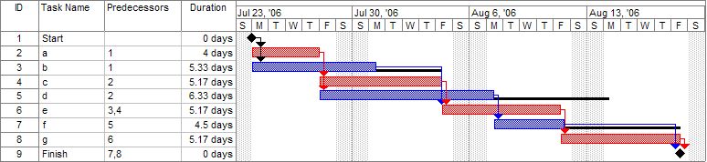
Gantt chart: Notation
Gantt, H.L. (1910). "Work, Wages and Profit". Engineering Magazine. New York.
Activity timeline
Activity with float time (dark)
Milestone
Using Microsoft project

Slide 35
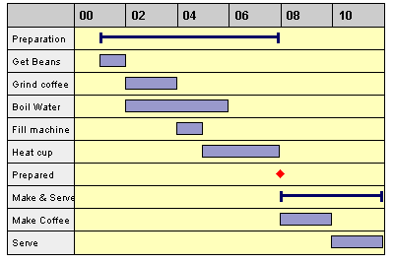
Gantt Chart with Summary and Milestones

Slide 36
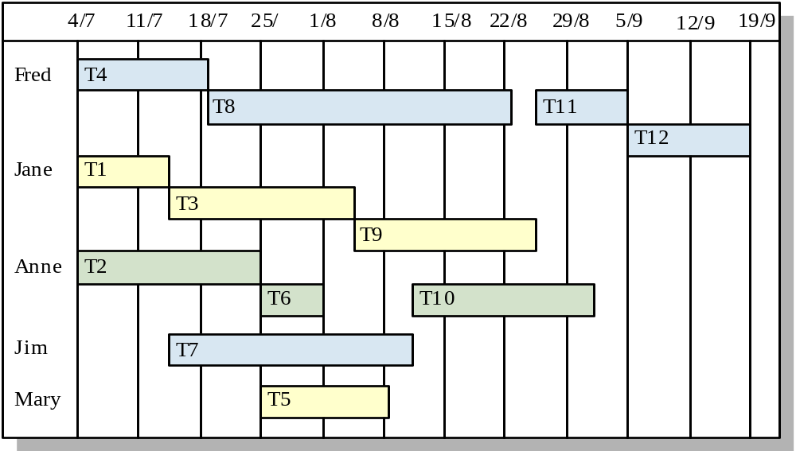
Other Uses of Gantt Chart
Staff Workload

Slide 37
Summary
Basics of software project management
  The aspects: what to be managed
  The means: how to manage
Key techniques of software project management
  Risk management
    The notion of risk and types of risks
    Activities and processes
      Risk identification, risk planning, risk assessment, risk monitoring,
  Project planning
    Activities and processes:
      Task analysis: identification and decomposition
      Product analysis: decomposition and relating to tasks
      Resource analysis: estimation of resource requirements
      Resource allocation and scheduling:
    Techniques:
      Pert chart, Gantt chart

Slide 38
Further Readings
Sommerville, I., Software Engineering, 9th Eds. 2011, Pearson.
  Chapter 22: Project Management
  Chapter 23: Project planning
  Chapter 25: Configuration management
Pressman, R. S., and Ince, D. Software Engineering: A Practitioner’s Approach, 5th Eds. McGraw Hill.
  Chapter 5: Software Project Planning
  Chapter 6: Risk Analysis and Management
  Chapter 7: Project Scheduling and Tracking

